Slide 1

The Adventures of
Theseus

Slide 2

Ons Team
David
Maaike
Walter
Gerwin
Janneke
Rilana
Producer
Lead Artist
Lead Developer
Level Design
UX
QA

Slide 3
Inhoud
Verhaal
Gameplay
Art Style
Resource Budget
Level Design
User Interface
Mechanics
Organisatie

Slide 4
verhaal
Volg de avonturen van Theseus vanaf zijn 18e tot en met zijn dood.
Aanpassingen voor een extra fantasie gevoel

Slide 5
gameplay
First person adventure game
with RPG elements
Overcome obstacles by using your brain not your raw power
Interesting quests and boss battles

Slide 6
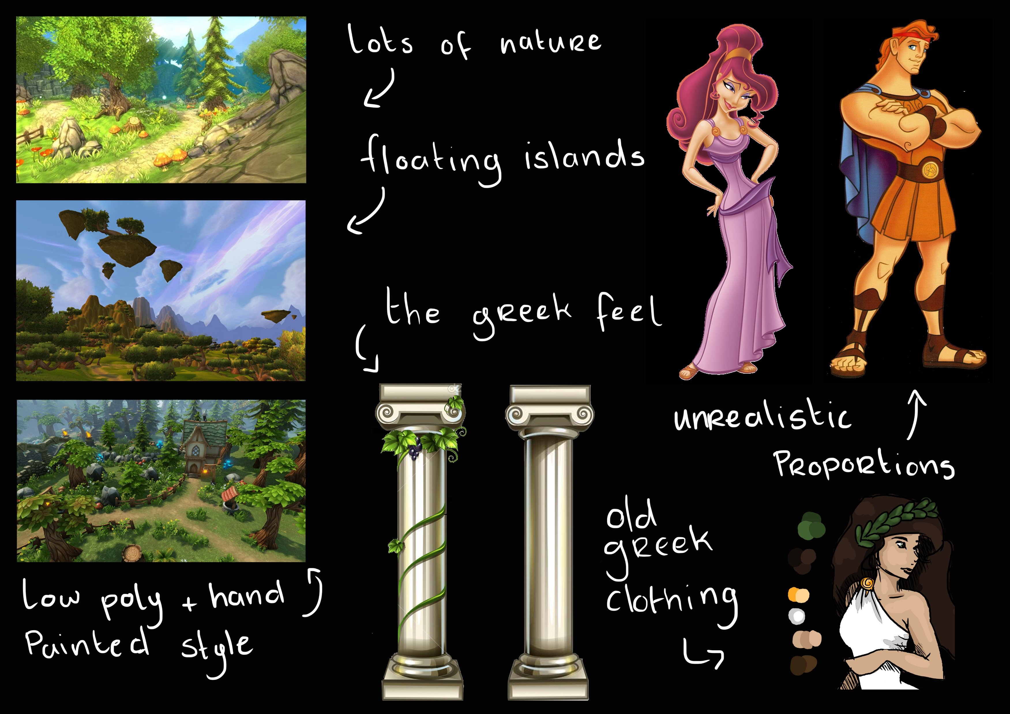
Art style

Slide 7

resource Budget
Characters
Xxx Polys
Buildings
Xxx Polys
Props Environmental
Xxx Polys

Slide 8
user Interface

Slide 9
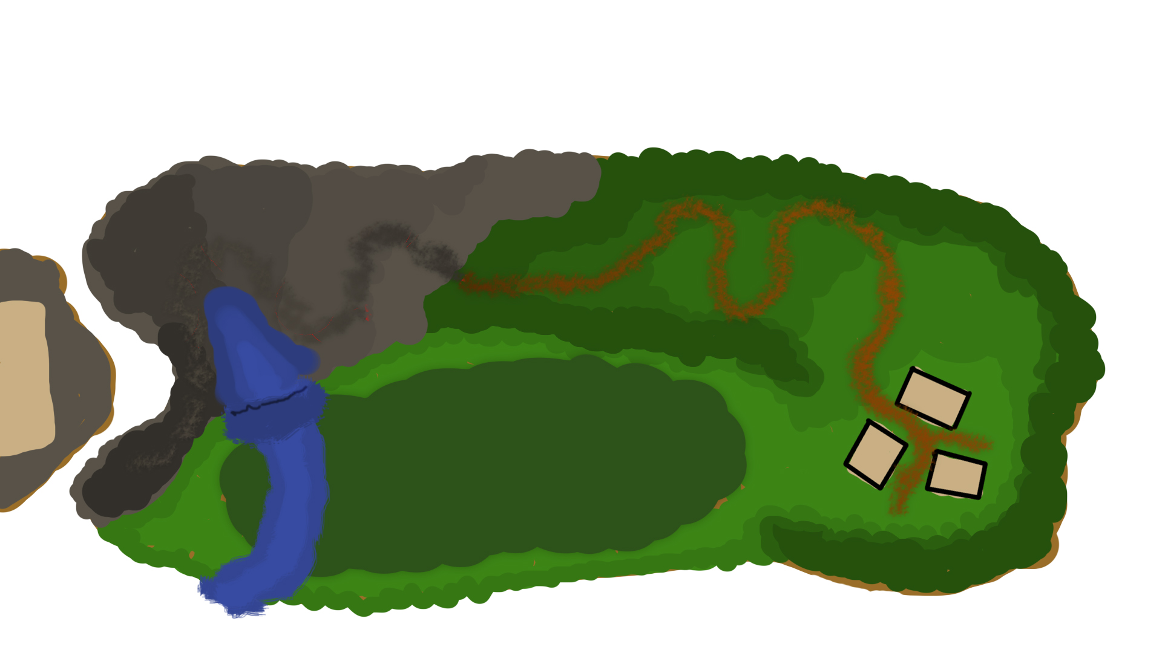
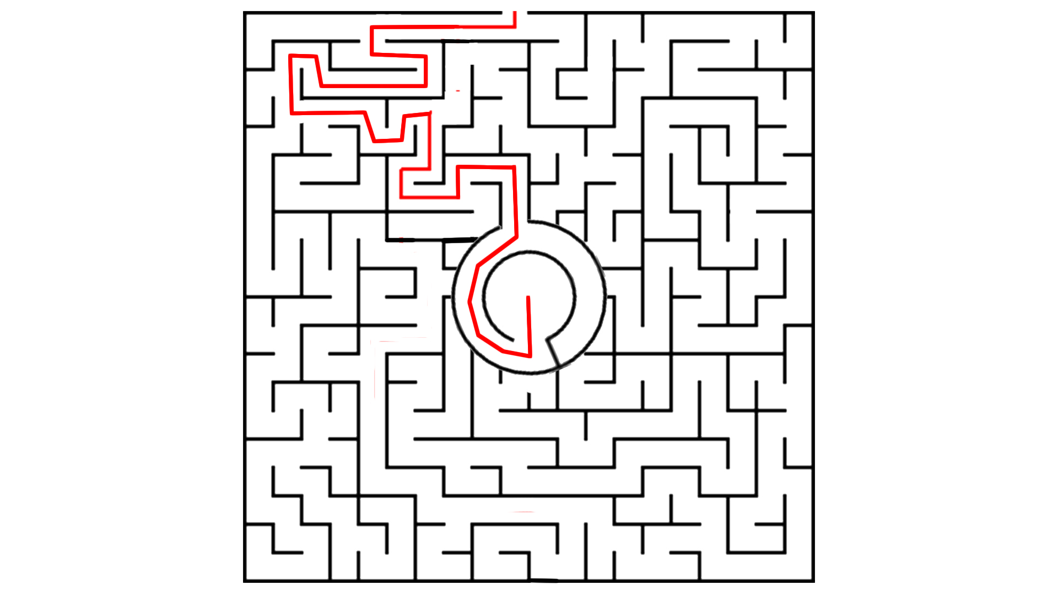
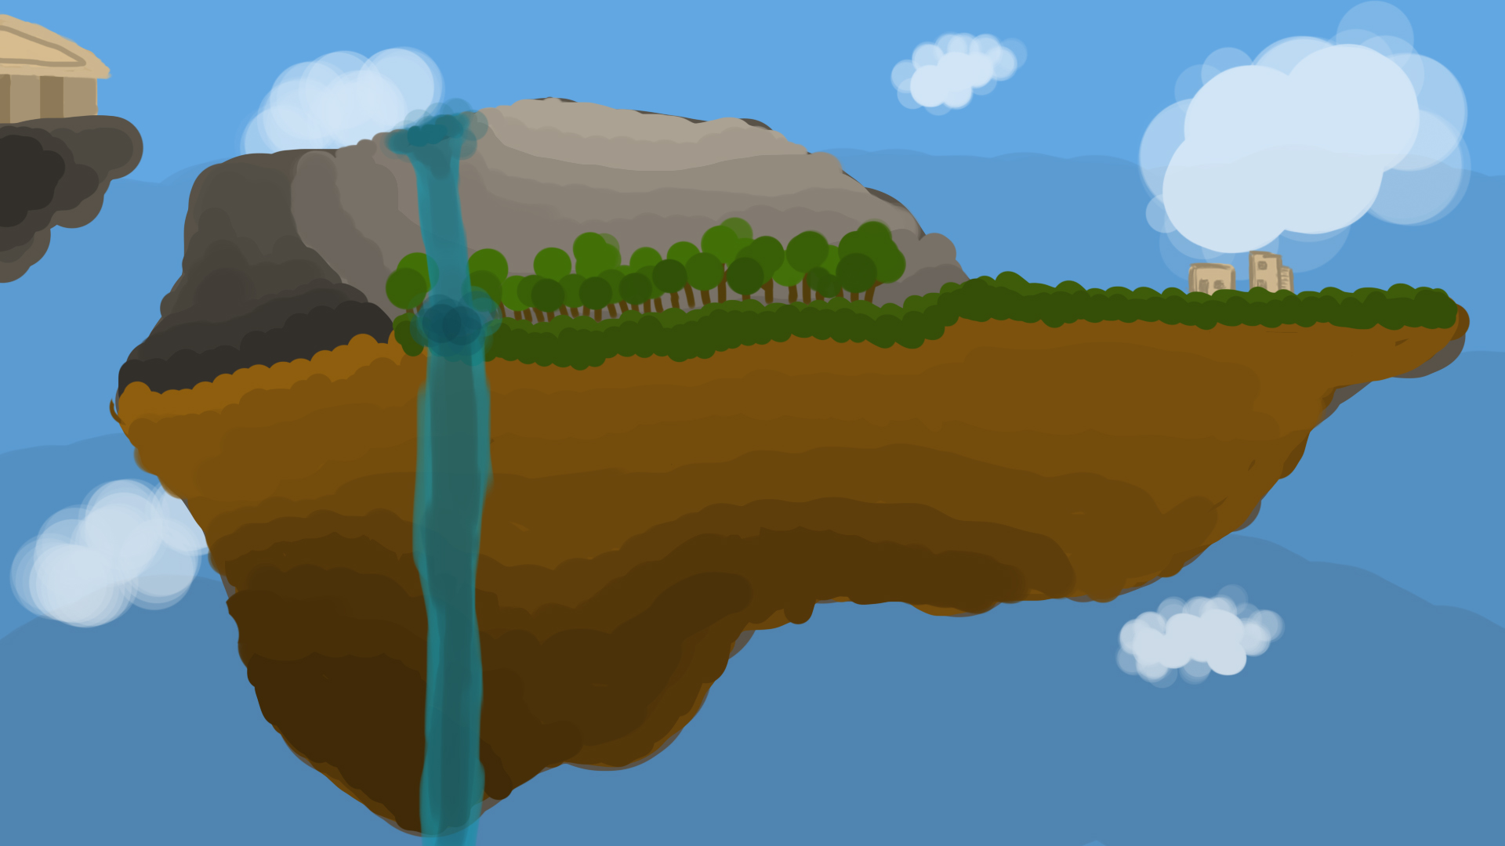
level design

Slide 10
Mechanics
First person camera with movement
And simple melee weapon combat
Inventory for storing items and crafting materials
Dialogue system to gather needed information, items and recipes
Exciting boss fights where just blindly attacking the boss won’t bring you victory

Slide 12
Organisatie

Slide 13
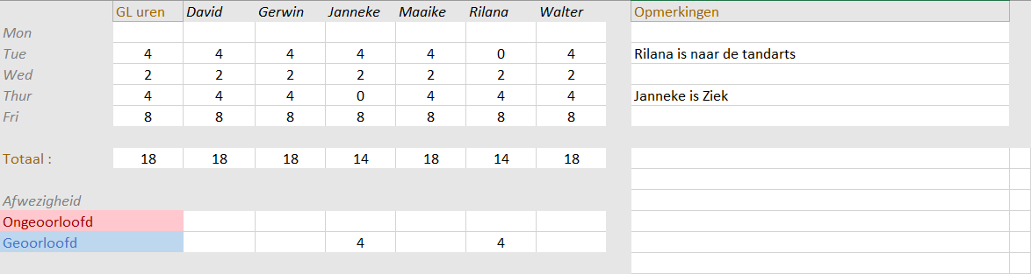
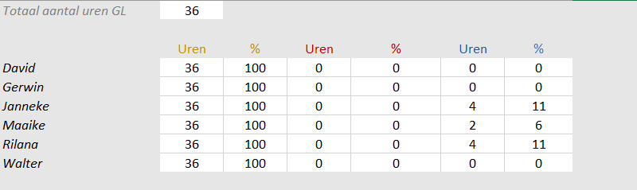
Organisatie

Slide 14
End
vragen?

